Slide 1
Colour Palette Details
NOTE: Copying slides between presentation files that do not have this Colour Theme may cause text and object colours to change.
Brand colour
For titles only
Functional colours
Use these colours for charts and graphs / for shapes
KN Dark blue
Standard text
RGB 0-51-105
Hex #003369
KN Dark blue
Standard text
RGB 0 -51-105
Hex #003369
Light blue
Turquoise accent 1
RGB 0-153-218
Hex #0099DA
Light Green
Green accent 2
RGB 8-199-146
Hex #08C792
Coral Red
Red accent 3
RGB 237-41-57
Hex #ED2939
Neutral 4
RGB 98-99-91
Hex # 62635B
Neutral 3
RGB 146-146-136
Hex # 929288
Chart colour sequence:
→
→
→
→
→
Text colour
For text boxes
Neutrals
Black
Standard text
RGB 0-0-0
Hex #000000
Neutral 1
RGB 246-245-240
Hex # F6F5F0
Neutral 2
RGB 197-198-191
Hex # C5C6BF
Neutral 3
RGB 146-146-136
Hex # 929288
Neutral 4
RGB 98-99-91
Hex # 62635B
Neutral 5
RGB 55-56-50
Hex # 373832

Slide 2

Item 1 18pt
Item 2
Item 3
Item 4
Item 5
Item 6
Item 7
Item 8
Item 9
Notes:
This layout is designed with a white logo for images with dark colour tones
Agenda Title Font: Arial bold 24pt bold KN dark blue Agenda Item Font: Arial bold 18pt black
Replace the picture: Click the existing picture and delete it. Then click on the icon and select a
new picture to insert. Using the Picture Change option is not recommended as it doesn’t crop images to
fit the space properly. Important: Swapping images automatically brings them to the front of all
elements on the slide. If your new picture is covering up other objects on the page, right click on
the image and choose Send to Back.

Slide 3
IOT Internet Of Things
Notes:
This is the standard title slide. It’s used as the very first slide of a Kuehne+Nagel presentation.
See next slide for alternative version with space for customer logos when needed.
Date Font: Arial bold 18pt white Main Title Font: Arial bold 36pt white Presentation Details Font: Arial 24pt white

Slide 4
Notes:
This end slide is to be used in all presentations
Do not add other elements to the slide.

Slide 5

Notes:
This title slide layout is designed with text for images with medium to dark colour tones.
Images must be chosen to fit with the layout and allow text to be seen.
You may need to make shorter sentences to fit the space around your chosen image.
Main Title Font: Arial bold 36pt white Presentation Details Font: Arial 24pt white
Overlay: There is a subtle overlay of black gradient underneath the text. This ensures that the text will stand out if the background of the image is in a middle colour range.
Replace the picture: Click the existing picture and delete it. Then click on the icon and select a
new picture to insert. Using the Picture Change option is not recommended as it doesn’t crop images to
fit the space properly. Important: Swapping images automatically brings them to the front of all
elements on the slide. If your new picture is covering up other objects on the page, right click on the
image and choose Send to Back.

Slide 6


Notes:
Agenda Title Font: Arial bold 36pt white Agenda Item Font: Arial bold 18pt white

Slide 7
Agenda
Item 1 18pt
Item 2
Item 3
Item 4
Item 5
Item 6
Item 7
Item 8
Item 9
Item 10
Item 11
Item 12
Item 13
Item 14
Item 15
Item 16
Notes:
Agenda Title Font: Arial bold 36pt white Agenda Item Font: Arial bold 18pt white

Slide 8








IOT Ecosytem
Applications
Smart Factory
Asset Management
Fleet Management
Smart Contracts
Platforms
Data Acquisition Systems
Sensors/Actuators
Notes:
Title Font: Arial bold 24pt KN Dark blue Body Text Font: Arial 18pt black

Slide 9
























IOT Ecosytem
Applications
Smart Factory
Asset management
Fleet Management
Smart Contracts
Energy Management
Smart cities
…
Platforms
Device management
Integration endpoints
Real time analytics
Rules Engine
Storage
Big Data
Devices
Micro Controller Board
Single Board Computer
Network Gateway
Edge Server
Data Acquisition System
Sensors/Actuators
temperature
humidity
pressure
proximity
level
accelerometer
Optical
gyroscope
infrared
…
Smart Contracts
System On Module
Notes:
Title Font: Arial bold 24pt KN Dark blue Body Text Font: Arial 18pt black

Slide 10
02
01
IOT Hardware
Main title, Arial bold 36pt
Subtitle, Arial regular 24pt
Notes:
Number Font: Arial bold 180pt white Key Message Font: Arial bold 36pt white Body Text Font: Arial 24pt white

Slide 11



IOT Hardware: IOT Solution
Physical
Environment
Sensor
Physical
Environm,
NETWORKING
SENSING
Electrical Signal
Sensor
Notes:
Physical World: Detect changes in physical environment. (Light, temperature, pressure..) Measure those changes with a certain accuracy.
Sometimes raw signal needs a Signal Conditioner to filter noise or amplify voltage to meet standards from receivers.

Slide 12
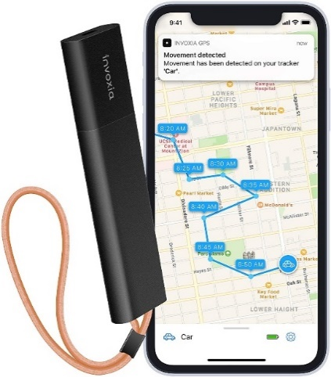
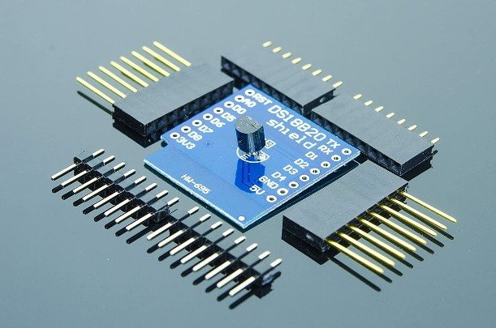
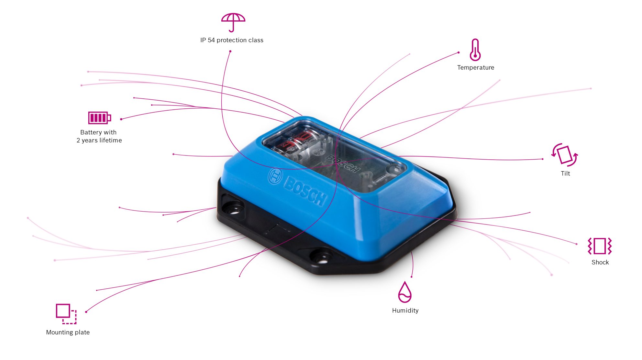
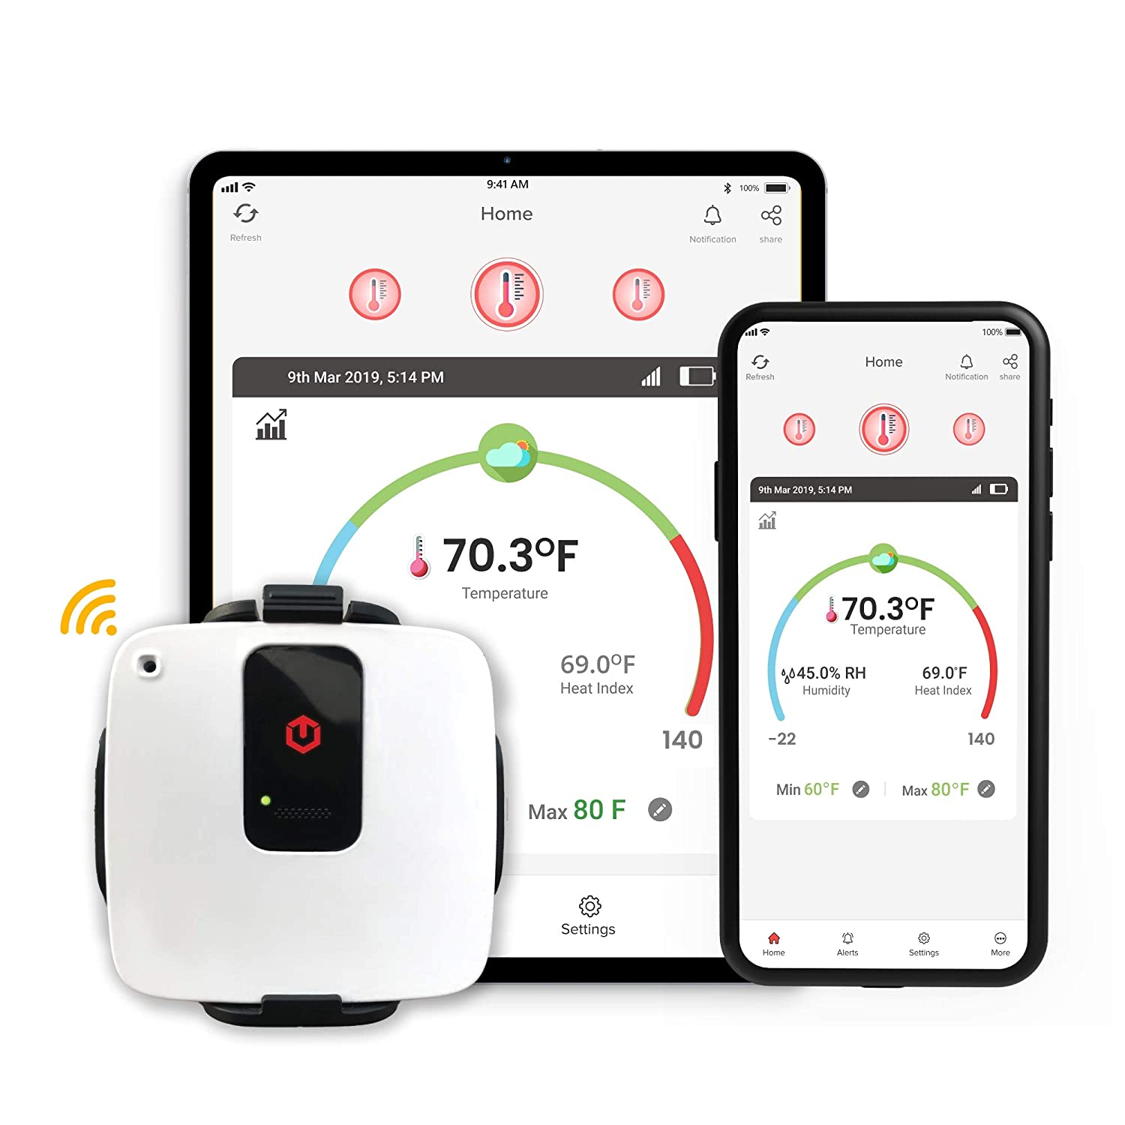
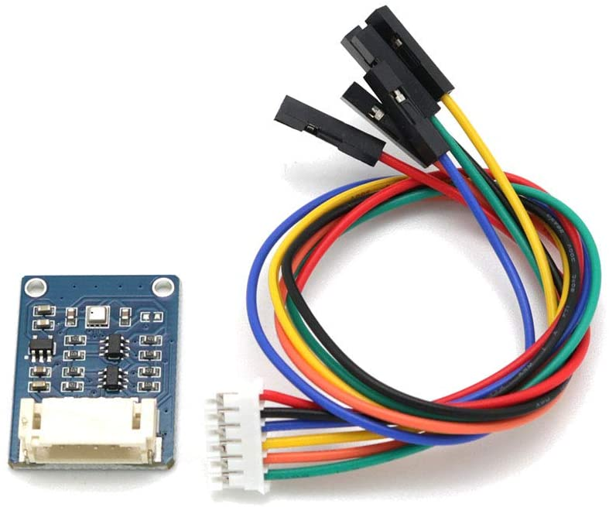
IOT Hardware: Sensors
Notes:
Title Font: Arial bold 24pt KN Dark blue Subtitle Font: Arial bold 18pt black Body Text Font: Arial 18pt black

Slide 13
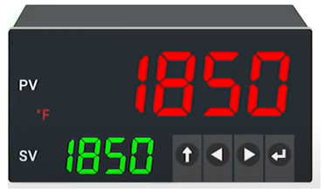


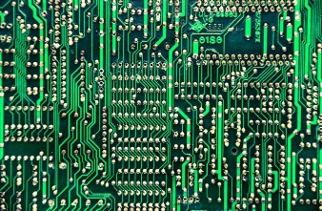
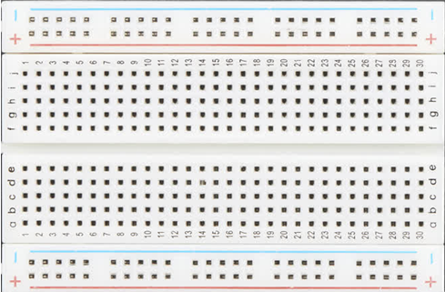







IOT Hardware: IOT Solution
Sensor
Physical World
Sensor
NETWORKING
Sensor
Notes:
Physical World: Detect changes in physical environment. (Light, temperature, pressure..) Measure those changes with a certain accuracy and convert it into an increasing voltage.
Sometimes raw signal needs a Signal Conditioner to filter noise or amplify voltage to meet standards from receivers.

Slide 14
IOT Hardware: IOT Solution
Physical World
Sense
Collect
Analyze
User Application
Sensor
Notes:
Physical World: Detect changes in physical environment. (Light, temperature, pressure..) Measure those changes with a certain accuracy.
Sometimes raw signal needs a Signal Conditioner to filter noise or amplify voltage to meet standards from receivers.

Slide 15
IOT Hardware: Sensors
Notes:
Title Font: Arial bold 24pt KN Dark blue Subtitle Font: Arial bold 18pt black Body Text Font: Arial 18pt black

Slide 16
IOT Hardware: Sensors
Enter subtitle text 18pt
Enter body text 18pt
Resolution
Notes:
Title Font: Arial bold 24pt KN Dark blue Subtitle Font: Arial bold 18pt black Body Text Font: Arial 18pt black

Slide 17
IOT Hardware: Microcontrollers vs Microprocessors
const int tempSensorPin = A1;
void setup() {
Serial.begin(9600);
}
void loop() {
int pinValue = analogRead(tempSensorPin);
Serial.println("Pin value: " + String(pinValue));
float voltage = (pinValue / 1024.0) * 5.0;
Serial.println("Voltage: " + String(voltage));
float temperature = (voltage - 0.5) * 100; // °C
Serial.println("Temperature: " + String(temperature)
);
delay(5000);
}
Notes:
Title Font: Arial bold 24pt KN Dark blue Subtitle Font: Arial bold 18pt black Body Text Font: Arial 18pt black

Slide 18
IOT Hardware: Arduino Code
const int tempSensorPin = A1;
void setup() {
Serial.begin(9600);
}
void loop() {
int pinValue = analogRead(tempSensorPin);
Serial.println("Pin value: " + String(pinValue));
float voltage = (pinValue / 1024.0) * 5.0;
Serial.println("Voltage: " + String(voltage));
float temperature = (voltage - 0.5) * 100; // °C
Serial.println("Temperature: " + String(temperature)
);
delay(5000);
}
Notes:
Title Font: Arial bold 24pt KN Dark blue Subtitle Font: Arial bold 18pt black Body Text Font: Arial 18pt black

Slide 19





IOT Hardware: Microcontrollers vs Microprocessors
Enter subtitle text 18pt
Enter body text 18pt
Notes:
Title Font: Arial bold 24pt KN Dark blue Subtitle Font: Arial bold 18pt black Body Text Font: Arial 18pt black

Slide 20
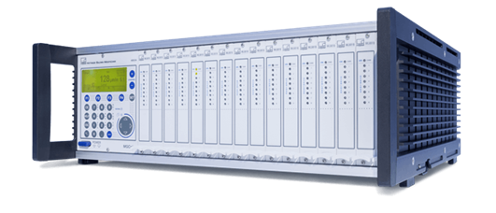
IOT Hardware: Data Acquisition System
Notes:
Title Font: Arial bold 24pt KN Dark blue Body Text Font: Arial 18pt black

Slide 21

IOT Hardware: Networking
Notes:
Title Font: Arial bold 24pt KN Dark blue Subtitle Font: Arial bold 18pt black Body Text Font: Arial 18pt black

Slide 22
IOT Hardware: Networking
Notes:
Title Font: Arial bold 24pt KN Dark blue Subtitle Font: Arial bold 18pt black Body Text Font: Arial 18pt black

Slide 23
IOT Hardware: Networking
Enter subtitle text 18pt
Enter body text 18pt
Notes:
Title Font: Arial bold 24pt KN Dark blue Subtitle Font: Arial bold 18pt black Body Text Font: Arial 18pt black

Slide 24
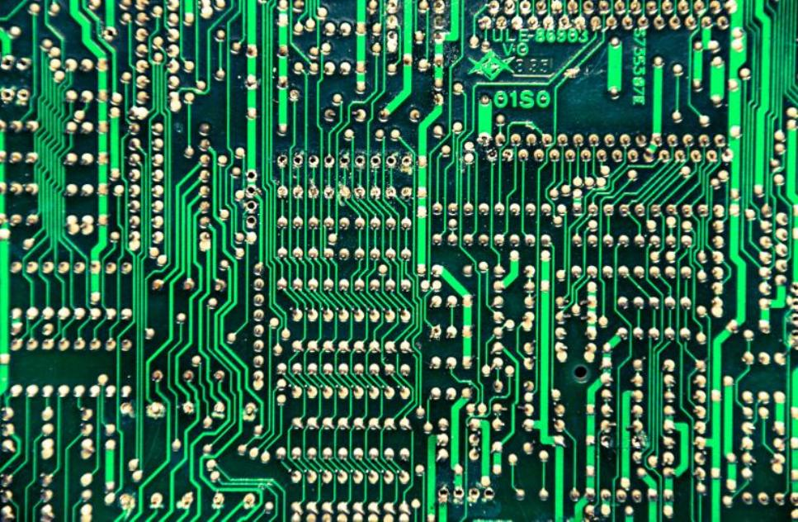
IOT Hardware: Printed Circuit Board
Enter subtitle text 18pt
Enter body text 18pt
Notes:
Title Font: Arial bold 24pt KN Dark blue Subtitle Font: Arial bold 18pt black Body Text Font: Arial 18pt black

Slide 25
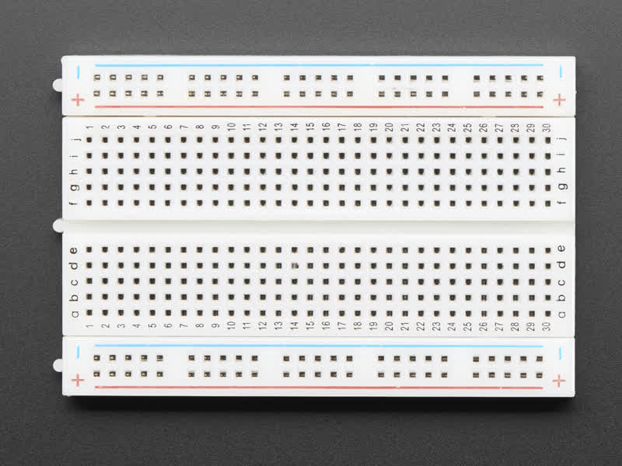
IOT Hardware: Bread Board
Enter subtitle text 18pt
Enter body text 18pt
Notes:
Title Font: Arial bold 24pt KN Dark blue Subtitle Font: Arial bold 18pt black Body Text Font: Arial 18pt black

Slide 26



IOT Hardware: Programming Boards
Mosquitto
MQTT Broker
Notes:
Title Font: Arial bold 24pt KN Dark blue Subtitle Font: Arial bold 18pt black Body Text Font: Arial 18pt black

Slide 27
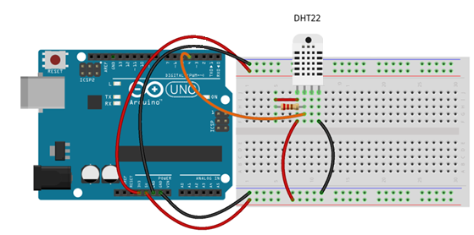
IOT Hardware: Micro Controller Board
Sensor
Controller
BreadBoard
Notes:
Title Font: Arial bold 24pt KN Dark blue Subtitle Font: Arial bold 18pt black Body Text Font: Arial 18pt black

Slide 28
02
02
Architectures
Main title, Arial bold 36pt
Subtitle, Arial regular 24pt
Notes:
Number Font: Arial bold 180pt white Key Message Font: Arial bold 36pt white Body Text Font: Arial 24pt white

Slide 29
Section 2
Architecture

Slide 30
IOT Architectures: IOT application layers
Enter subtitle text 18pt
Enter body text 18pt
Notes:
Title Font: Arial bold 24pt KN Dark blue Subtitle Font: Arial bold 18pt black Body Text Font: Arial 18pt black

Slide 31
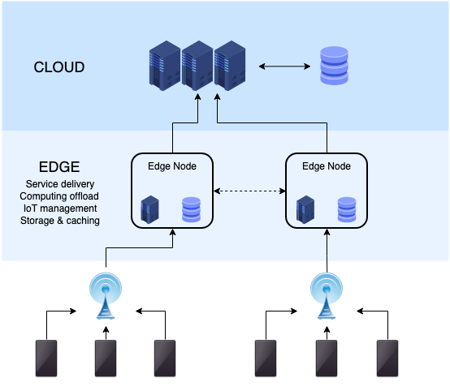
IOT Architectures: IOT Analytics at the Edge
Notes:
Title Font: Arial bold 24pt KN Dark blue Subtitle Font: Arial bold 18pt black Body Text Font: Arial 18pt black

Slide 32
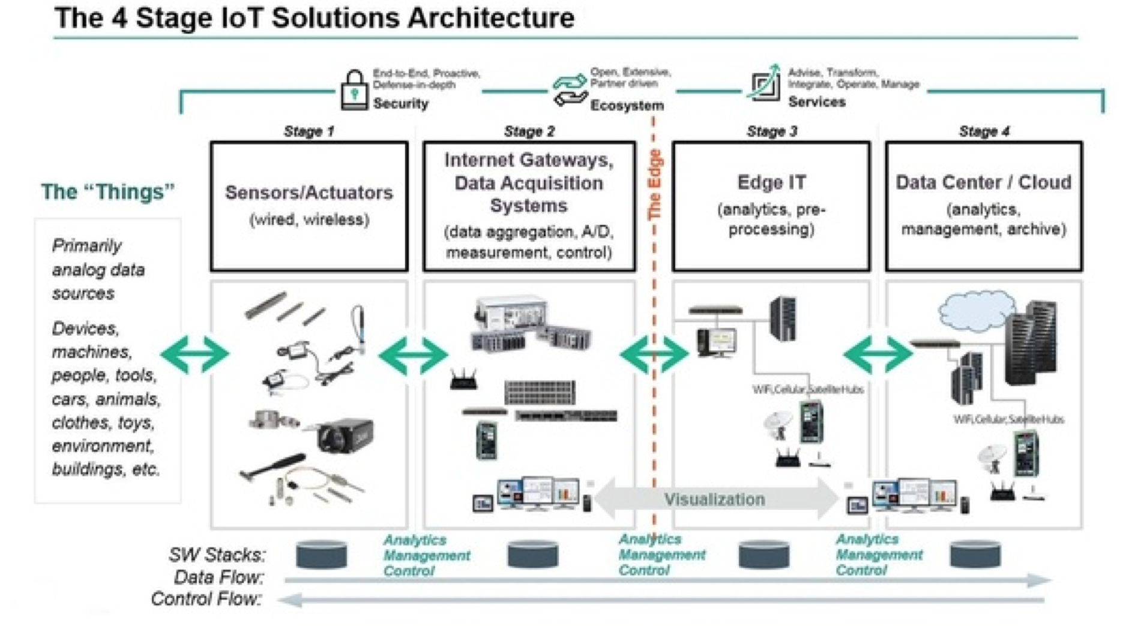
IOT Architectures: IOT Analytics at the Edge
Notes:
Title Font: Arial bold 24pt KN Dark blue Subtitle Font: Arial bold 18pt black Body Text Font: Arial 18pt black

Slide 33
02
03
IOT Programming
Main title, Arial bold 36pt
Subtitle, Arial regular 24pt
Notes:
Number Font: Arial bold 180pt white Key Message Font: Arial bold 36pt white Body Text Font: Arial 24pt white

Slide 34
Programming IOT: Sensor data acquisition
Arduino
Enter bullet point level two
Enter bullet point level three
Enter bullet point level three
Notes:
Title Font: Arial bold 24pt KN Dark blue Bullet Point Level 1 Font: Arial bold 18pt black
Bullet Point Level 2 & 3 Font: Arial 18pt black

Slide 35
IOT Code: Sensor data acquisition
Raspberry Enter bullet point level two
Enter bullet point level three
Enter bullet point level three
Enter bullet point level one 18pt
Enter bullet point level two
Enter bullet point level three
Enter bullet point level three
Notes:
Title Font: Arial bold 24pt KN Dark blue Bullet Point Level 1 Font: Arial bold 18pt black
Bullet Point Level 2 & 3 Font: Arial 18pt black

Slide 36
IOT Code: Sensor data acquisition
Pixieboard Enter bullet point level two
Enter bullet point level three
Enter bullet point level three
Enter bullet point level one 18pt
Enter bullet point level two
Enter bullet point level three
Enter bullet point level three
Notes:
Title Font: Arial bold 24pt KN Dark blue Bullet Point Level 1 Font: Arial bold 18pt black
Bullet Point Level 2 & 3 Font: Arial 18pt black

Slide 37
IOT Code: Java and IOT
Enter bullet point level one 18pt
Enter bullet point level two
Enter bullet point level three
Enter bullet point level three
Enter bullet point level one 18pt
Enter bullet point level two
Enter bullet point level three
Enter bullet point level three
Notes:
Title Font: Arial bold 24pt KN Dark blue Bullet Point Level 1 Font: Arial bold 18pt black
Bullet Point Level 2 & 3 Font: Arial 18pt black

Slide 38
IOT Code: Java and IOT protocols
Enter bullet point level one 18pt
Enter bullet point level two
Enter bullet point level three
Enter bullet point level three
Enter bullet point level one 18pt
Enter bullet point level two
Enter bullet point level three
Enter bullet point level three
Notes:
Title Font: Arial bold 24pt KN Dark blue Bullet Point Level 1 Font: Arial bold 18pt black
Bullet Point Level 2 & 3 Font: Arial 18pt black

Slide 39
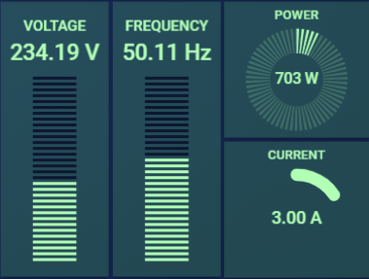
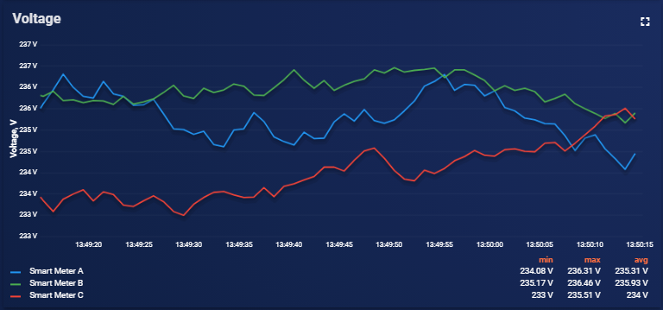
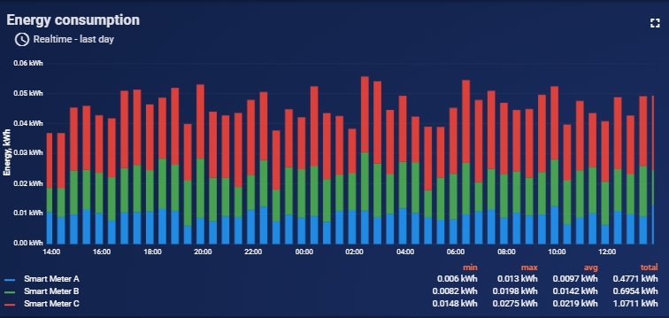

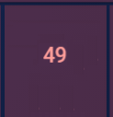
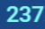
IOT Code: Java and IOT protocols
Notes:
Title Font: Arial bold 24pt KN Dark blue Bullet Point Level 1 Font: Arial bold 18pt black
Bullet Point Level 2 & 3 Font: Arial 18pt black

Slide 40
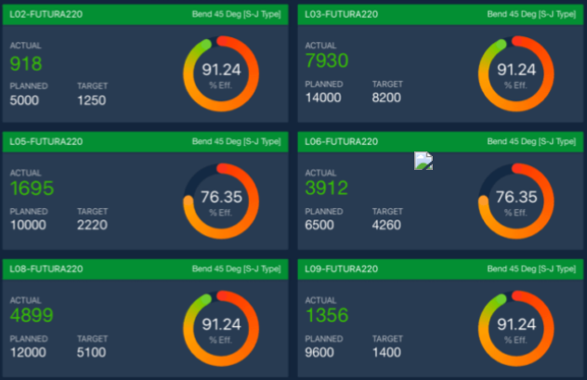
Notes:
Title Font: Arial bold 24pt KN Dark blue Bullet Point Level 1 Font: Arial bold 18pt black
Bullet Point Level 2 & 3 Font: Arial 18pt black

Slide 41
Enter key message text in this area. You can highlight specific words or phrases to make them stand out by changing the colour to light blue.
Text is 36pt
Notes:
Key Message Font: Arial bold 36pt white

Slide 42
Enter key message 36pt
Enter body text 24pt
Notes:
Key Message Font: Arial bold 36pt black Body Text Font: Arial 24pt black

Slide 43
Enter key message 36pt
Enter body text 24pt
Notes:
Key Message Font: Arial bold 36pt white Body Text Font : Arial 24pt white

Slide 44
02
01
Enter key message on these two lines 36pt
Enter body text 24pt
Main title, Arial bold 36pt
Subtitle, Arial regular 24pt
Notes:
Number Font: Arial bold 180pt white Key Message Font: Arial bold 36pt white Body Text Font: Arial 24pt white

Slide 45
02
02
Enter key message on these two lines 36pt
Enter body text 24pt
Main title, Arial bold 36pt
Subtitle, Arial regular 24pt
Notes:
Number Font: Arial bold 180pt white Key Message Font: Arial bold 36pt white Body Text Font: Arial 24pt white

Slide 46
Section 4
Text with
images

Slide 47

Enter key message text 36pt
Enter body text 24pt
Notes:
Key Message Font: Arial bold 36pt black Body Text Font: Arial 24pt black
Replace the picture: Click the existing picture and delete it. Then click on the icon and select a
new picture to insert. Using the Picture Change option is not recommended as it doesn’t crop images to
fit the space properly. Important: Swapping images automatically brings them to the front of all
elements on the slide. If your new picture is covering up other objects on the page, right click on
the image and choose Send to Back.

Slide 48
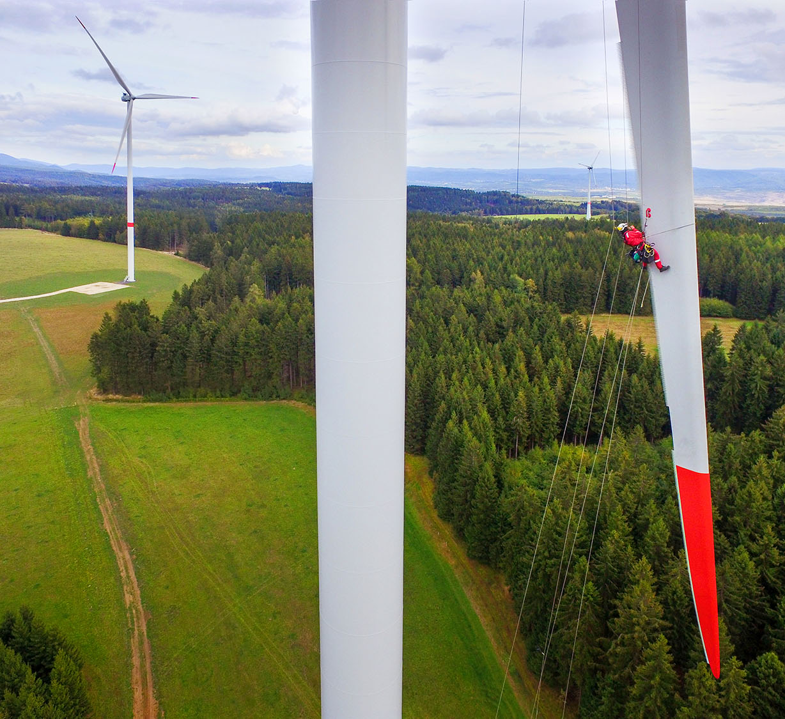
Enter key message 36pt
Enter body text 24pt
Notes:
This layout is designed with a standard logo for images with light colour tones
Key Message Font: Arial bold 36pt white Body Text Font: Arial 24pt white
Replace the picture: Click the existing picture and delete it. Then click on the icon and select a
new picture to insert. Using the Picture Change option is not recommended as it doesn’t crop images to
fit the space properly. Important: Swapping images automatically brings them to the front of all
elements on the slide. If your new picture is covering up other objects on the page, right click on
the image and choose Send to Back.

Slide 49

Enter key message 36pt
Enter body text 24pt
Notes:
This layout is designed with a white logo for images with dark colour tones
Key Message Font: Arial bold 36pt white Body Text Font: Arial 24pt white
Replace the picture: Click the existing picture and delete it. Then click on the icon and select a
new picture to insert. Using the Picture Change option is not recommended as it doesn’t crop images to
fit the space properly. Important: Swapping images automatically brings them to the front of all
elements on the slide. If your new picture is covering up other objects on the page, right click on
the image and choose Send to Back.

Slide 50
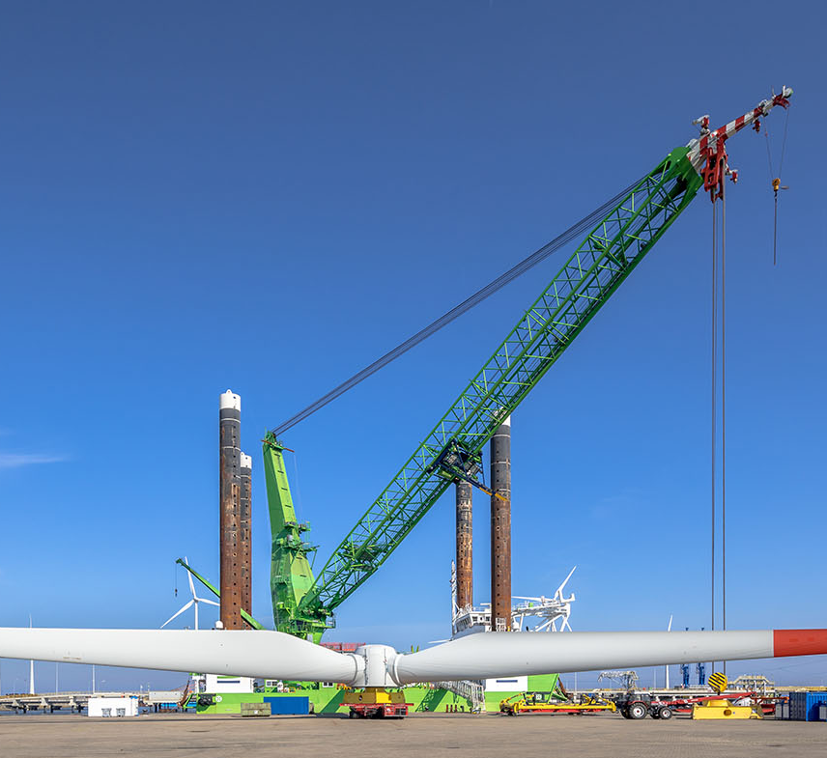
Enter a key message with specific words highlighted in light blue.
Text is 36pt
Notes:
This layout is designed with a white logo for images with dark colour tones
Key Message Font: Arial bold 36pt white Body Text Font: Arial 24pt white
Replace the picture: Click the existing picture and delete it. Then click on the icon and select a
new picture to insert. Using the Picture Change option is not recommended as it doesn’t crop images to
fit the space properly. Important: Swapping images automatically brings them to the front of all
elements on the slide. If your new picture is covering up other objects on the page, right click on
the image and choose Send to Back.

Slide 51

Enter a key message with specific words highlighted in light blue.
Text is 36pt
Notes:
This layout is designed with a standard logo for images with light colour tones
Key Message Font: Arial bold 36pt white Body Text Font: Arial 24pt white
Replace the picture: Click the existing picture and delete it. Then click on the icon and select a
new picture to insert. Using the Picture Change option is not recommended as it doesn’t crop images to
fit the space properly. Important: Swapping images automatically brings them to the front of all
elements on the slide. If your new picture is covering up other objects on the page, right click on
the image and choose Send to Back.

Slide 52

Enter key message text 36pt
Enter body text 24pt
Notes:
Key Message Font: Arial bold 36pt white Body Text Font: Arial 24pt white
Replace the picture: Click the existing picture and delete it. Then click on the icon and select a
new picture to insert. Using the Picture Change option is not recommended as it doesn’t crop images to
fit the space properly. Important: Swapping images automatically brings them to the front of all
elements on the slide. If your new picture is covering up other objects on the page, right click on
the image and choose Send to Back.

Slide 53
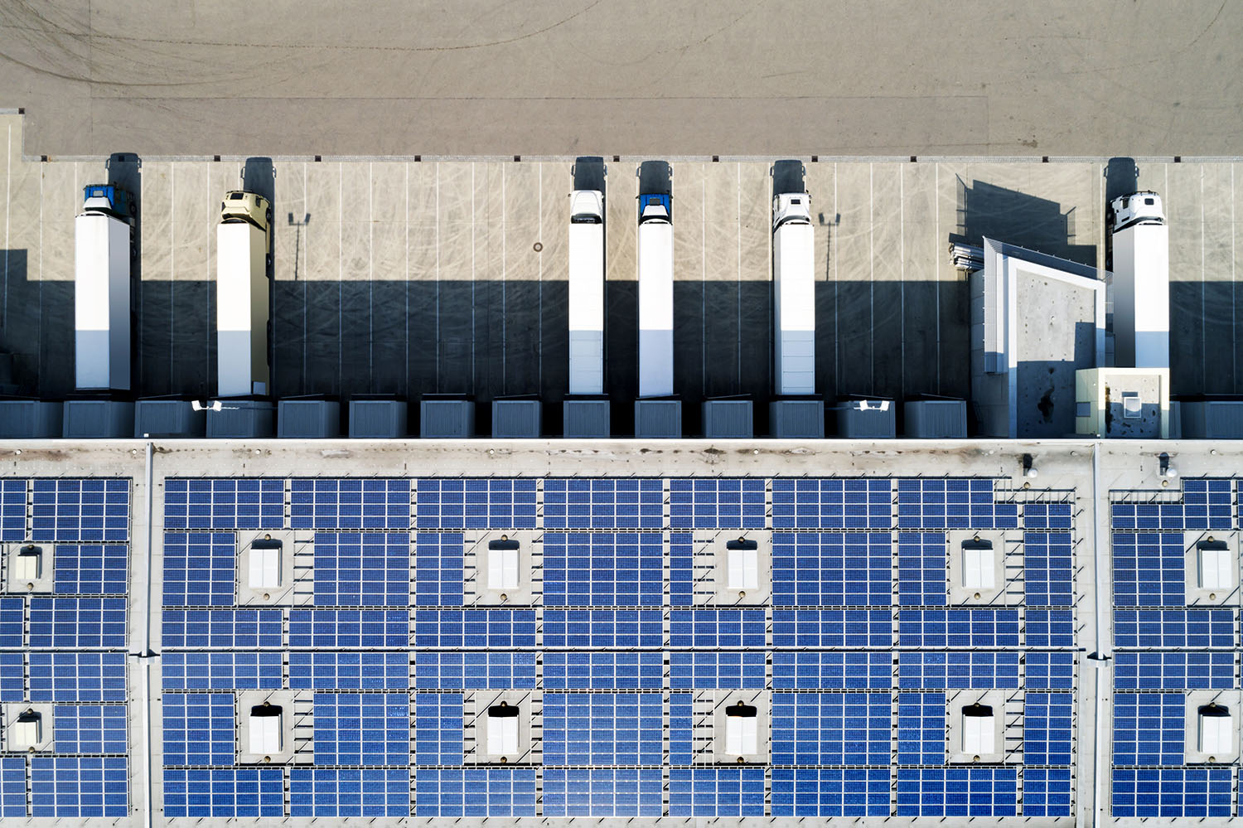
Enter subtitle text 18pt
Enter body text 18pt
Notes:
Title Font: Arial bold 24pt KN Dark blue Subtitle Font: Arial bold 18pt black Text Font: Arial 18pt black
Replace the pictureClick the existing picture and delete it. Then click on the icon and select a
new picture to insert. Using the Picture Change option is not recommended as it doesn’t crop images to
fit the space properly. Important: Swapping images automatically brings them to the front of all
elements on the slide. If your new picture is covering up other objects on the page, right click on
the image and choose Send to Back.

Slide 54

Enter subtitle text 18pt
Enter body text 18pt
Notes:
This layout is designed with a standard logo for images with light colour tones
Title Font: Arial bold 24pt KN Dark blue Subtitle Font: Arial bold 18pt black Text Font: Arial 18pt black
Replace the picture: Click the existing picture and delete it. Then click on the icon and select a
new picture to insert. Using the Picture Change option is not recommended as it doesn’t crop images to
fit the space properly. Important: Swapping images automatically brings them to the front of all
elements on the slide. If your new picture is covering up other objects on the page, right click on
the image and choose Send to Back.

Slide 55

Enter subtitle text 18pt
Enter body text 18pt
Notes:
This layout is designed with a white logo for images with dark colour tones
Title Font: Arial bold 24pt KN Dark blue Subtitle Font: Arial bold 18pt black Text Font: Arial 18pt black
Replace the picture: Click the existing picture and delete it. Then click on the icon and select a
new picture to insert. Using the Picture Change option is not recommended as it doesn’t crop images to
fit the space properly. Important: Swapping images automatically brings them to the front of all
elements on the slide. If your new picture is covering up other objects on the page, right click on
the image and choose Send to Back.

Slide 56



Challenge
Solution
Results
Notes:
This layout is designed with a standard logo for images with light colour tones
Title Font: Arial bold 24pt KN Dark blue Case study section font: Arial bold 18pt black Text Font: Arial 14pt black
Change the icons: You may swap the icons for ones you prefer in Frontify
Replace the picture: Click the existing picture and delete it. Then click on the icon and select a
new picture to insert. Using the Picture Change option is not recommended as it doesn’t crop images to
fit the space properly. Important: Swapping images automatically brings them to the front of all
elements on the slide. If your new picture is covering up other objects on the page, right click on
the image and choose Send to Back.

Slide 57

Challenge
Solution
Results
Notes:
This layout is designed with a white logo for images with dark colour tones
Title Font: Arial bold 24pt KN Dark blue Case study section font: Arial bold 18pt black Text Font: Arial 14pt black
Change the icons: You may swap the icons for ones you prefer in Frontify
Replace the picture: Click the existing picture and delete it. Then click on the icon and select a
new picture to insert. Using the Picture Change option is not recommended as it doesn’t crop images to
fit the space properly. Important: Swapping images automatically brings them to the front of all
elements on the slide. If your new picture is covering up other objects on the page, right click on
the image and choose Send to Back.

Slide 58

Challenge
Solution
Results
Notes:
Title Font: Arial bold 24pt KN Dark blue Case study section font: Arial bold 18pt black Text Font: Arial 14pt black
Replace the picture: Click the existing picture and delete it. Then click on the icon and select a
new picture to insert. Using the Picture Change option is not recommended as it doesn’t crop images to
fit the space properly. Important: Swapping images automatically brings them to the front of all
elements on the slide. If your new picture is covering up other objects on the page, right click on
the image and choose Send to Back.

Slide 59
Challenge
Solution
Results
Notes:
Title Font: Arial bold 24pt KN Dark blue Case study section font: Arial bold 18pt black Text Font: Arial 14pt black
Change the icons: You may swap the icons for ones you prefer in Frontify

Slide 60
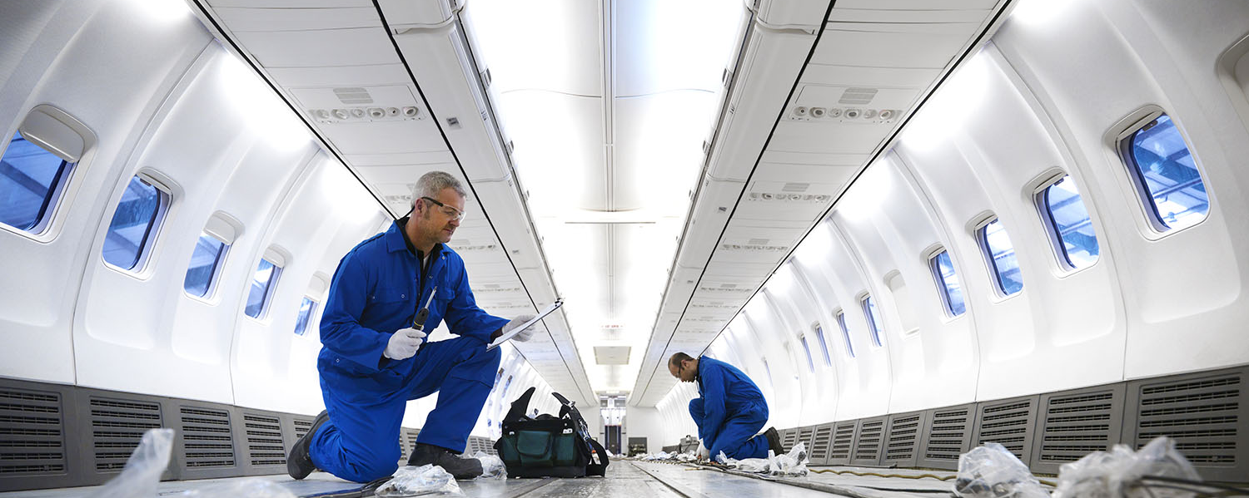
Enter key message 24pt
Notes:
This layout is designed with a standard logo for images with light colour tones
Message Font: Arial bold 24pt white
Replace the picture: Click the existing picture and delete it. Then click on the icon and select a
new picture to insert. Using the Picture Change option is not recommended as it doesn’t crop images to
fit the space properly. Important: Swapping images automatically brings them to the front of all
elements on the slide. If your new picture is covering up other objects on the page, right click on
the image and choose Send to Back.

Slide 61
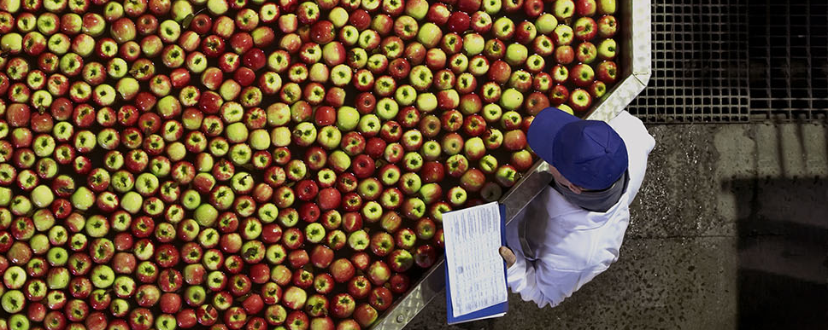
Enter key message 24pt
Notes:
This layout is designed with a standard logo for images with dark colour tones
Message Font: Arial bold 24pt white
Replace the picture: Click the existing picture and delete it. Then click on the icon and select a
new picture to insert. Using the Picture Change option is not recommended as it doesn’t crop images to
fit the space properly. Important: Swapping images automatically brings them to the front of all
elements on the slide. If your new picture is covering up other objects on the page, right click on
the image and choose Send to Back.

Slide 62

Enter body text 18pt
Notes:
Title Font: Arial bold 24pt KN dark blue Body Text Font: Arial 18pt black
Replace the picture: Click the existing picture and delete it. Then click on the icon and select a
new picture to insert. Using the Picture Change option is not recommended as it doesn’t crop images to
fit the space properly. Important: Swapping images automatically brings them to the front of all
elements on the slide. If your new picture is covering up other objects on the page, right click on
the image and choose Send to Back.

Slide 63


Enter body text 18pt
Notes:
Title Font: Arial bold 24pt KN Dark blue Body Text Font: Arial 18pt black
Replace the picture: Click the existing picture and delete it. Then click on the icon and select a
new picture to insert. Using the Picture Change option is not recommended as it doesn’t crop images to
fit the space properly. Important: Swapping images automatically brings them to the front of all
elements on the slide. If your new picture is covering up other objects on the page, right click on
the image and choose Send to Back.

Slide 64

Enter key message or title text 36pt
Enter body text 24pt
Notes:
This layout is designed with a standard logo for images with light colour tones
Message Font: Arial bold 36pt white Body Text Font: Arial 24pt white
Replace the picture: Click the existing picture and delete it. Then click on the icon and select a
new picture to insert. Using the Picture Change option is not recommended as it doesn’t crop images to
fit the space properly. Important: Swapping images automatically brings them to the front of all
elements on the slide. If your new picture is covering up other objects on the page, right click on
the image and choose Send to Back.

Slide 65

Enter key message or title text 36pt
Enter body text 24pt
Notes:
This layout is designed with a standard logo for images with light colour tones
Message Font: Arial bold 36pt white Body Text Font: Arial 24pt white
Replace the picture: Click the existing picture and delete it. Then click on the icon and select a
new picture to insert. Using the Picture Change option is not recommended as it doesn’t crop images to
fit the space properly. Important: Swapping images automatically brings them to the front of all
elements on the slide. If your new picture is covering up other objects on the page, right click on
the image and choose Send to Back.

Slide 66

Enter a key message with specific words highlighted in light blue. Text is 36pt
Notes:
This layout is designed with a standard logo for images with light colour tones
Message Font: Arial bold 36pt white Body Text Font: Arial 24pt white
Replace the picture: Click the existing picture and delete it. Then click on the icon and select a
new picture to insert. Using the Picture Change option is not recommended as it doesn’t crop images to
fit the space properly. Important: Swapping images automatically brings them to the front of all
elements on the slide. If your new picture is covering up other objects on the page, right click on
the image and choose Send to Back.

Slide 67

Enter a key message with specific words highlighted in light blue. Text is 36pt
Notes:
This layout is designed with a standard logo for images with light colour tones
Message Font: Arial bold 36pt white Body Text Font: Arial 24pt white
Replace the picture: Click the existing picture and delete it. Then click on the icon and select a
new picture to insert. Using the Picture Change option is not recommended as it doesn’t crop images to
fit the space properly. Important: Swapping images automatically brings them to the front of all
elements on the slide. If your new picture is covering up other objects on the page, right click on
the image and choose Send to Back.

Slide 68

Title text 36pt
“quote text 24pt – enter up to a maximum of 7 lines”
Notes:
This layout is designed with a standard logo for images with dark colour tones
Message Font: Arial bold 36pt white Quote Text Font: Arial 24pt white
Replace the picture: Click the existing picture and delete it. Then click on the icon and select a
new picture to insert. Using the Picture Change option is not recommended as it doesn’t crop images to
fit the space properly. Important: Swapping images automatically brings them to the front of all
elements on the slide. If your new picture is covering up other objects on the page, right click on
the image and choose Send to Back.

Slide 69

Title text 36pt
“quote text 24pt – enter up to a maximum of 7 lines”
Notes:
This layout is designed with a white logo for images with dark colour tones
Message Font: Arial bold 36pt white Quote Text Font: Arial 24pt white
Replace the picture: Click the existing picture and delete it. Then click on the icon and select a
new picture to insert. Using the Picture Change option is not recommended as it doesn’t crop images to
fit the space properly. Important: Swapping images automatically brings them to the front of all
elements on the slide. If your new picture is covering up other objects on the page, right click on
the image and choose Send to Back.

Slide 70

Enter key message or title text 36pt
Enter body text 24pt
Notes:
Message Font: Arial bold 36pt white Body Text Font: Arial 24pt white
Replace the picture: Click the existing picture and delete it. Then click on the icon and select a
new picture to insert. Using the Picture Change option is not recommended as it doesn’t crop images to
fit the space properly. Important: Swapping images automatically brings them to the front of all
elements on the slide. If your new picture is covering up other objects on the page, right click on
the image and choose Send to Back.

Slide 71

Enter a key message with specific words highlighted in light blue. Text is 36pt
Notes:
Message Font: Arial bold 36pt white Body Text Font: Arial 24pt white
Replace the picture: Click the existing picture and delete it. Then click on the icon and select a
new picture to insert. Using the Picture Change option is not recommended as it doesn’t crop images to
fit the space properly. Important: Swapping images automatically brings them to the front of all
elements on the slide. If your new picture is covering up other objects on the page, right click on
the image and choose Send to Back.

Slide 72

Enter key message or title text 36pt
Enter body text 24pt
Notes:
This layout is designed with a white logo for images with dark colour tones
Message Font: Arial bold 36pt white Body Text Font: Arial 24pt white
Replace the picture: : Click the existing picture and delete it. Then click on the icon and select a
new picture to insert. Using the Picture Change option is not recommended as it doesn’t crop images to
fit the space properly. Important: Swapping images automatically brings them to the front of all
elements on the slide. If your new picture is covering up other objects on the page, right click on
the image and choose Send to Back.

Slide 73

Enter key message or title text 36pt
Enter body text 24pt
Notes:
This layout is designed with a standard logo for images with light colour tones
Message Font: Arial bold 36pt white Body Text Font: Arial 24pt white
Replace the picture: Click the existing picture and delete it. Then click on the icon and select a
new picture to insert. Using the Picture Change option is not recommended as it doesn’t crop images to
fit the space properly. Important: Swapping images automatically brings them to the front of all
elements on the slide. If your new picture is covering up other objects on the page, right click on
the image and choose Send to Back.

Slide 74

Q&A

Slide 75

Notes:
Main title font: Arial bold 24pt Dark blue Column title font: Arial 18pt bold black
Column body text font: Arial 14pt black
Replace the picture: Click the existing picture and delete it. Then click on the icon and select a
new picture to insert. Using the Picture Change option is not recommended as it doesn’t crop images to
fit the space properly. Important: Swapping images automatically brings them to the front of all
elements on the slide. If your new picture is covering up other objects on the page, right click on
the image and choose Send to Back.

Slide 76



Notes:
Main title font: Arial bold 24pt Dark blue Column title font: Arial 18pt bold black
Column body text font: Arial 14pt black
Replace the picture: Click the existing picture and delete it. Then click on the icon and select a
new picture to insert. Using the Picture Change option is not recommended as it doesn’t crop images to
fit the space properly. Important: Swapping images automatically brings them to the front of all
elements on the slide. If your new picture is covering up other objects on the page, right click on
the image and choose Send to Back.

Slide 77


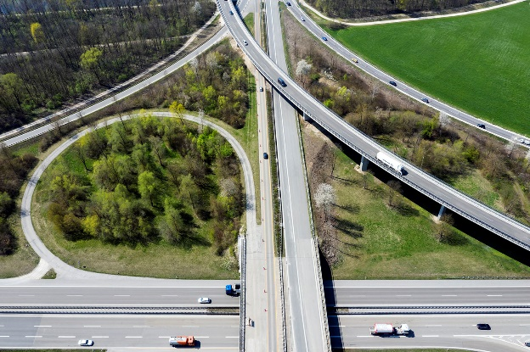

Notes:
Main title font: Arial bold 24pt Dark blue Column title font: Arial 18pt bold black
Column body text font: Arial 14pt black
Replace the picture: Click the existing picture and delete it. Then click on the icon and select a
new picture to insert. Using the Picture Change option is not recommended as it doesn’t crop images to
fit the space properly. Important: Swapping images automatically brings them to the front of all
elements on the slide. If your new picture is covering up other objects on the page, right click on
the image and choose Send to Back.

Slide 78
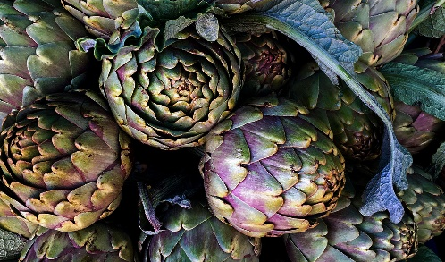

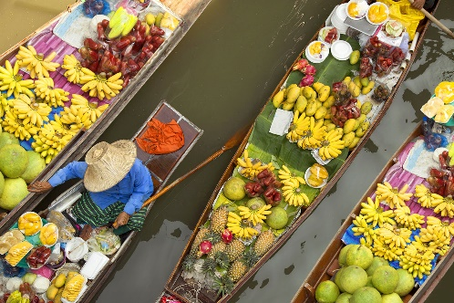

Notes:
Main title font: Arial bold 24pt Dark blue Column title font: Arial 18pt bold black
Column body text font: Arial 14pt black
Replace the picture: Click the existing picture and delete it. Then click on the icon and select a
new picture to insert. Using the Picture Change option is not recommended as it doesn’t crop images to
fit the space properly. Important: Swapping images automatically brings them to the front of all
elements on the slide. If your new picture is covering up other objects on the page, right click on
the image and choose Send to Back.

Slide 79

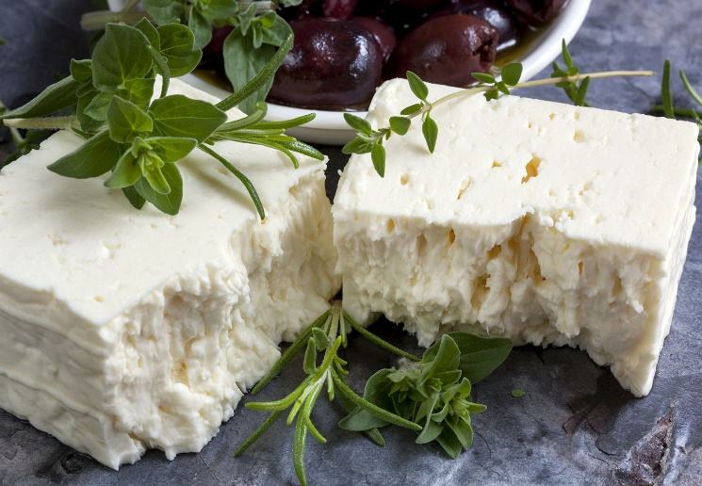

Notes:
Main title font: Arial bold 24pt Dark blue Column title font: Arial 18pt bold black
Column body text font: Arial 14pt black
Replace the picture: Click the existing picture and delete it. Then click on the icon and select a
new picture to insert. Using the Picture Change option is not recommended as it doesn’t crop images to
fit the space properly. Important: Swapping images automatically brings them to the front of all
elements on the slide. If your new picture is covering up other objects on the page, right click on
the image and choose Send to Back.

Slide 80

Notes:
Main title font: Arial bold 24pt Dark blue Message text font: Arial 36pt bold black
Replace the picture: Click the existing picture and delete it. Then click on the icon and select a
new picture to insert. Using the Picture Change option is not recommended as it doesn’t crop images to
fit the space properly. Important: Swapping images automatically brings them to the front of all
elements on the slide. If your new picture is covering up other objects on the page, right click on
the image and choose Send to Back.

Slide 81

Notes:
Main title font: Arial bold 24pt Dark blue Message text font: Arial 36pt bold black
Replace the picture: Click the existing picture and delete it. Then click on the icon and select a
new picture to insert. Using the Picture Change option is not recommended as it doesn’t crop images to
fit the space properly. Important: Swapping images automatically brings them to the front of all
elements on the slide. If your new picture is covering up other objects on the page, right click on
the image and choose Send to Back.

Slide 82



Notes:
Main title font: Arial bold 24pt Dark blue Body Text Font: Arial 14pt black
Replace the pictures: Click the existing picture and delete it. Then click on the icon and select a
new picture to insert. Using the Picture Change option is not recommended as it doesn’t crop images to
fit the space properly. Important: Swapping images automatically brings them to the front of all
elements on the slide. If your new picture is covering up other objects on the page, right click on
the image and choose Send to Back.

Slide 83
Section 5
Tables and
charts

Slide 84
Table title text 18pt
Title, Arial bold 14pt | Title | Title | Title | Title
Category 1, Arial regular 14pt
Category 2
Category 3
Category 4
Total
Title, Arial bold 14pt | Title | Title | Title | Title
Category 1, Arial regular 14pt
Category 2
Category 3
Category 4
Total
Notes:
Title Font: Arial bold 24pt KN Dark blue Table Title Font: Arial bold 18pt black
Table Font: Arial 14pt: Bold white for title, black for data, and Bold black for Total Line

Slide 85
Table title text 18pt
Title, Arial bold 14pt | Title | Title | Title | Title
Category 1, Arial regular 14pt
Category 2
Category 3
Category 4
Total
Notes:
Title Font: Arial bold 24pt KN Dark blue Table Title Font: Arial bold 18pt black
Table Font: Arial 14pt: Bold white for title, black for data, and Bold black for Total Line

Slide 86
Table Title 18pt
Table body text 18pt
Title, Arial bold 14pt | Title | Title
Category 1, Arial regular 14pt
Category 2
Category 3
Category 4
Total
Notes:
Title Font: Arial bold 24pt KN Dark blue Table Body Text: Arial 18pt black
Table Title Font: Arial bold 18pt black
Table Font: Arial 14pt: Bold white for title, black for data, and Bold black for Total Line

Slide 87
Table body text 18pt
Title, Arial bold 14pt | Title | Title
Category 1, Arial regular 14pt
Category 2
Category 3
Category 4
Total
Notes:
Title Font: Arial bold 24pt KN Dark blue Table Body Text: Arial 18pt black
Table Font: Arial 14pt: Bold white for title, black for data, and Bold black for Total Line

Slide 88
Table title text 18pt
Body text 18pt
Notes:
Title Font: Arial bold 24pt KN Dark blue Chart Title Text: Arial Bold 18pt black
Chart Body Text: Arial 18pt black Chart Legend Font: Arial 14pt (chart colours default)

Slide 89
Graphic body text 18pt
Notes:
Title Font: Arial bold 24pt KN Dark blue Chart Body Text: Arial 18pt black
Chart Legend Font: Arial 14pt (chart colour defaults)

Slide 90
Notes:
Title Font: Arial bold 24pt KN Dark blue Chart Title Text: Arial Bold 18pt black
Chart Body Text: Arial 18pt black Chart Legend Font: Arial 14pt (chart colours default)

Slide 91
60%
76%
35%
10%
Chart title text 18pt
Body text 14pt
Notes:
Title Font: Arial bold 24pt KN Dark blue Chart Title Text: Arial bold 18pt black
Chart Body Text Font: Arial 14pt white Chart Text Lines: Arial Bold 14pt (chart colour defaults)

Slide 92
60%
76%
35%
10%
Notes:
Main title font: Arial bold 24pt KN dark blue
Chart colours: Light gray with 1. dark blue 2. light blue 3. light green 4. gray accent 6
Bar chart number font: Arial bold 18pt black Chart text font: Arial 16pt black
Changing the bar chart: Click on the outermost bounding box. Right click on the edge
and select Edit Data. Enter the amount you want to show in colour in the first column and the
balance in the second (add up to 100%.) Close the data window. Update the % text directly on
each chart to match your amount shown.

Slide 93
Notes:
Title Font: Arial bold 24pt KN Dark blue Graphic Text: Arial 14pt bold black

Slide 94
Circle text description
Chart body text 18pt
Chart Title
Circle text description
Circle text description
Notes:
Title Font: Arial bold 24pt KN Dark blue Chart Body Text: Arial 18pt black
Chart Ttile Font: Arial Bold 18pt white Chart Text Lines Font: Arial Bold 14pt black

Slide 95
Circle text description
Chart body text 18pt
Chart Title
Circle text description
Circle text description
Notes:
Title Font: Arial bold 24pt KN Dark blue Chart Body Text: Arial 18pt black
Chart Ttile Font: Arial Bold 18pt white Circle Text Description Font: Arial Bold 14pt white

Slide 96
Notes:
Title Font: Arial bold 24pt KN Dark blue Graphic Body Text: Arial 18pt black
Chart Sections Text Font: Arial Bold 24pt white Chart Legend Text: Arial Bold 14pt (chart colour defaults)

Slide 97
Graphic body text 18pt
Enter text in this
section of the circle
Enter text in this
section of the circle
Enter text in this
section of the circle
Notes:
Title Font: Arial bold 24pt KN Dark blue Graphic Body Text: Arial 18pt black
Graphic Sections Text Font: Arial Bold 16pt white

Slide 98
Graphic body text 18pt
Enter text in this
section of the circle
Enter text in this
section of the circle
Enter text in this
section of the circle
Enter text in this
section of the circle
Notes:
Title Font: Arial bold 24pt KN Dark blue Graphic Body Text: Arial 18pt black
Graphic Sections Text Font: Arial Bold 16pt white

Slide 99
Org chart body text 18pt
Text
Text
Text
Text
Text
Text
Text
Text
Text
Text
Text
Text
Text
Text
Text
Notes:
Title Font: Arial bold 24pt KN Dark blue Org Chart Body Text: Arial 18pt black
Org Chart Boxes Text Font: Arial 10pt white

Slide 100
Text
Text
Text
Text
Text
Text
Text
Text
Text
Text
Text
Text
Text
Text
Text
Notes:
Title Font: Arial bold 24pt KN Dark blue Org Chart Boxes Text Font: Arial 10pt white

Slide 101
Name
Title
Name
Title
Name
Title
Name
Title
Name
Title
Name
Title
Name
Title
Name
Title
Name
Title
Name
Title
Name
Title
Name
Title
Name
Title
Name
Title
Name
Title
Name
Title
Name
Title
Notes:
Title Font: Arial bold 24pt KN Dark blue Org Chart Boxes Text Font: Arial 10pt white

Slide 102
Text
Text
Text
Text
Text
Text
Text
Text
Text
Text
Text
Text
Text
Text
Text
Text
Text
Notes:
Title Font: Arial bold 24pt KN Dark blue Org Chart Boxes Text Font: Arial 10pt white

Slide 103
Section 6
Information
graphics

Slide 104
Notes:
Main title font: Arial bold 24pt Dark blue Box title font: Arial 24pt bold black + white
Box description font: Arial 14pt black + white

Slide 105
Notes:
Main title font: Arial bold 24pt Dark blue Box title font: Arial 24pt bold black + white
Box description font: Arial 14pt black + white

Slide 106
Notes:
Main title font: Arial bold 24pt Dark blue Box title font: Arial 24pt bold black + white
Box description font: Arial 18pt black + white

Slide 107
SWOT slide
Notes:
Main title font: Arial bold 24pt KN dark blue SWOT letters: Arial bold 60pt white
SWOT titles font: Arial bold 18pt black Text details font: Arial 16pt black

Slide 108
65%
35%
15%
75%
Enter text up to 5 lines
Enter text up to 5 lines
Enter text up to 5 lines
Enter text up to 5 lines
Notes:
This is an animated slide. To remove, click on the Animations tab and open the Animation Pane.
Click on each of the activities in the pane to delete or press SHIFT+A to select all and delete.
Main title font: Arial bold 24pt KN dark blue Circle text font: Arial 14pt black
Ring colours: Light gray with 1. dark blue 2. light blue 3. Light Green 4. Gray accent 6
Circle number font: Arial bold 24pt black
Changing the circle charts: Click to on the outermost bounding box of each chart.
(do not select the smaller inner square) Right click and choose Edit Data.
Enter data in the 2 rows as indicated so they equal 100, then close the data window.
Change the text box in the middle of the circle to match your percentage.

Slide 109
Status scale:
On schedule
In progress
On hold
Activity
Status
Line item
Line item
Line item
Line item
Line item
Line item
Line item
Line item
Line item
Notes:
Main title font: Arial bold 24pt KN dark blue
Column font: Arial bold 18pt white Line item font: Arial 14pt black
Using the status buttons: Option 1: Click on each of the coloured circles
you do not need and change the Shape Fill colour to KN Gray 25%
Option 2: Delete the coloured circles you do not need for each line item.
If you want align the remaining circles, hold down the SHIFT key and click on
each until all are selected. At the top of your screen, select the DRAWING TOOLS
tab and select ALIGN tab and Align Center from the drop-down options.
CHANGE STATUS SCALE TEXT: Each is grouped with the colour circle.
Click on the text to change so it represents your own scale

Slide 110
Activities | Col 1 | Col 2 | Col 3 | Col 4 | Col 5 | Col 6 | Col 7 | Col 8 | Col 9
Activity 1
Activity 2
Activity 3
Activity 4
Activity 5
Activity 6
Activity 7
Activity 8
Notes:
Title Font: Arial bold 24pt KN Dark blue Table font title row: Arial 12pt bold white
Table font remaining rows: Arial 12pt black

Slide 111
Enter text to a maximum
of 2 lines.
Enter text to a maximum
of 2 lines.
2016
2018
2020
2017
2019
Enter text to a maximum
of 2 lines.
Enter text to a maximum
of 2 lines.
Enter text to a maximum
of 2 lines.
Notes:
Main title font: Arial bold 24pt KN dark blue
Circle colours / outlines: 1. dark blue, 2. light blue 3. light green
4. dark blue, 5. light blue + other outlines in gray accent 6
Timeline font: Arial bold 32pt (colours match circles)
Timeline details font: Arial 12pt black

Slide 112







Enter text to a maximum of 3 lines.
Enter text to a maximum of 3 lines.
Enter text to a maximum of 3 lines.
Enter text to a maximum of 3 lines.
Enter text to a maximum of 3 lines.
Enter text to a maximum of 3 lines.
Enter text to a maximum of 3 lines.
Notes:
Main title font: Arial bold 24pt KN dark blue
Timeline details font: Arial 12pt black
Change the icons: You may swap the icons for ones you prefer in Frontify

Slide 113






Notes:
Main title font: Arial bold 24pt KN dark blue Section title font: Arial bold 24pt black
Section description font: Arial 12pt black
Change the icons: You may swap the icons for ones you prefer in Frontify

Slide 114





Enter information for first section up to a maximum of 5 lines.
Enter information for first section up to a maximum of 5 lines.
Enter information for first section up to a maximum of 5 lines.
Enter information for first section up to a maximum of 5 lines.
Enter information for first section up to a maximum of 5 lines.
Notes:
Main title font: Arial bold 24pt Dark blue
Text font: Arial 12pt black
Change the icons: You may swap the icons for ones you prefer in Frontify

Slide 115
Enter information for first section up to a maximum of 5 lines.
Enter information for first section up to a maximum of 5 lines.
Enter information for first section up to a maximum of 5 lines.
Enter information for first section up to a maximum of 5 lines.
Enter information for first section up to a maximum of 5 lines.
Notes:
Main title font: Arial bold 24pt Dark blue
Text font: Arial 12pt black
Change the icons: You may swap the icons for ones you prefer in Frontify

Slide 116
Map body text 18pt
Notes:
Title Font: Arial bold 24pt KN dark blue Map Body Text Font: Arial 18pt black
Map Colour: KN Light green Map Markers: KN Dark blue and white
Change Map: You may swap the map for another you prefer from Frontify

Slide 117
Notes:
Title Font: Arial Bold 24pt KN Dark Blue Map Colour: KN Dark Blue Map Markers: KN Light Green
Change Map: You may swap the map for another you prefer from Frontify

Slide 118
Map body text 18pt
Notes:
Title Font: Arial bold 24pt KN dark blue Map Body Text Font: Arial 18pt black
Map Colour: Accent Grey #5, 60% lighter Map Markers: KN Dark blue, light blue, light green and coral red
Change Map: You may swap the map for another you prefer from Frontify

Slide 119
Map body text 18pt
Notes:
Title Font: Arial bold 24pt KN dark blue Map Body Text Font: Arial 18pt black
Map Colour: KN light blue Map Markers: white
Change Map: You may swap the map for another you prefer from Frontify

Slide 120
123
123
text description
text description
123
text description
123
text description
Notes:
@ Presenter: choose between this photo and the next one.
To ensure your product receives the care it requires, we have over 3500 GxP-trained staff working from 230+ operations globally, as well as 90 trained auditors who continuously validate our network. Our CareTeam provides 24/7 proactive intervention for your peace of mind.
Start presenting the benefits of KN PharmaChain
We have a large network and contacts worldwide.
No matter the type of product, we have a solution for you.
Even if you have unusual requests, we have a solution for you.
We are still feature rich and not 100% selling customer value.

Slide 121



Location title
Location name
Location title
Location name
Location title
Location name
Notes:
Main title font: Arial bold 24pt Dark blue
Number font: Arial bold 24pt white Text font: Arial 16pt white
Map location titles: Arial bold 14pt light blue Map location names: Arial bold 12pt black
Change the map and icons: You may swap the icons and map for ones you prefer in Frontify

Slide 122
23%
Location name
Enter information for this section to a maximum of 4 lines.
26%
Location name
55%
Enter information for this section to a maximum of 4 lines.
Location name
Enter information for this section to a maximum of 4 lines.
Notes:
Main Title Font: Arial bold 24pt KN dark blue Location Percentage: Arial bold 18pt black
Location Name: Arial bold 14pt white Location Details Font: Arial 14pt black
Location Box+line Colour: KN dark blue Line Adjustment: Lines may be repositioned from
the end dots. The Location text boxes will remain in the same place.
Map Colour: Accent Grey #5, 60% lighter + highlighted countries in KN light green
Colouring Map: Each country is a separate piece within the group. Click on the section
you want and change the colour within the palette range.
Change Map: You may swap the map for another you prefer from Frontify

Slide 123
Location name
Enter information for this section to a maximum of 2 lines.
Location name
Enter information for this section to a maximum of 2 lines.
Location name
Enter information for this section to a maximum of 2 lines.
Notes:
MAIN TITLE FONT: Arial bold 24pt KN dark blue LOCATION NAME: Arial bold 14pt white
LOCATION DETAILS FONT: Arial 14pt black LOCATION BOX+LINE COLOUR: KN dark blue
LINE ADJUSTMENT: Lines may be repositioned from the end dots. The location text boxes
will remain in the same place.
MAP COLOUR: Accent Grey #5, 60% lighter + highlighted countries in KN light blue
COLOURING MAP: Each country is a separate piece within the group. Click on the section you
want and change the colour within the palette range.
Change Map: You may swap the map for another you prefer from Frontify

Slide 124
Section 7
QSHE
safety slide

Slide 125




Safety moment Location, City, Country
Smoking areas outside of reception and cafeteria
In case of an evacuation, do not use the elevators
In case of an evacuation, follow the instructions of KN staff and signed. Meeting point
First aid kit is in room 06, opposite Reception, dial internal number 511

